Slide 1
Everything You Wanted to Know About CAMERA ANGLES
But were afraid to ASK!

Slide 2
Camera Angles
Camera Angles and movements combine to create a sequence of images, just as words, word order and punctuation combine to make the meaning of a sentence.
You need a straightforward set of key terms to describe them!

Slide 3
Describing Shots
When describing camera angles you have to think about three important factors:
1. FRAMING (or LENGTH) of the shot
2. The ANGLE of the shot
3. If there is any MOVEMENT involved
Each different shot has a different purpose and effect. Changing between shots is called a CUT.

Slide 4
Framing (Shot Length)
WIDE ANGLE SHOT
*Generally used as a scene-setting, establishing shot.
*Also referred to as an EXTERIOR (outside of buildings, landscape, action as in massive war or disaster film)
*Very little detail, meant to give general impression

Slide 5
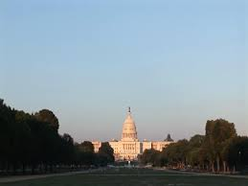
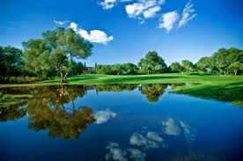
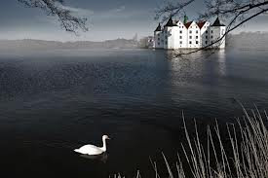
Wide Angle Examples

Slide 6
Framing (Shot Length)
LONG SHOT
*Generally shows image as “lifesize”.
*Full shot of entire human body, with head near the top, feet or ankles near the bottom.
*The focus is on the actors, but plenty of background appears in detail

Slide 7
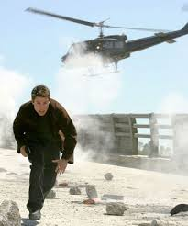
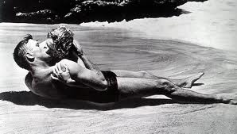
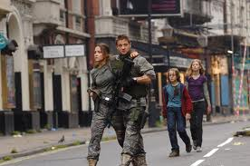
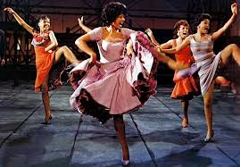
Long Shot Examples

Slide 8
Framing (Shot Length)
MEDIUM SHOT (Most commonly used shot.)
Approx shows figures from the waist up (with leeway).
Also know as a Two (or Three) Shot, based on number of people.
Great for dialogue and/or show some detail of action
A little background visible, that has already been established

Slide 9
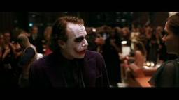
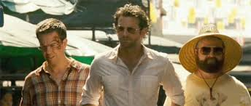
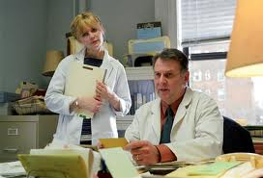
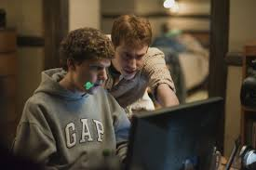
Medium Shot Examples

Slide 10
Framing (Shot Length)
CLOSE UP
Almost no background visible
Concentrates on full face (shoulders can be present)
Objects would fully fill the screen
Magnifies the importance of face/object
Brings us into the mind of character, think: personal space issues.

Slide 11
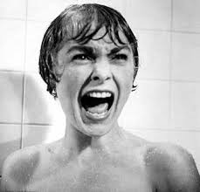
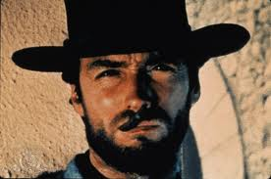
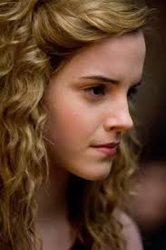
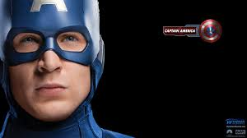
Close Up Examples

Slide 12
Framing (Shot Length)
EXTREME CLOSE UP
Considered a SFX
A part of an object (eyes, mouth) filling up the screen
A small object (a quarter, a football) filling up the scene

Slide 13
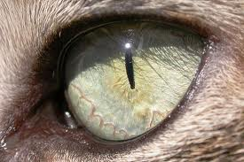
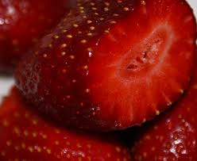
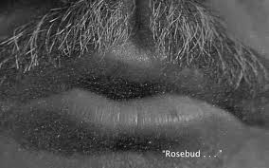
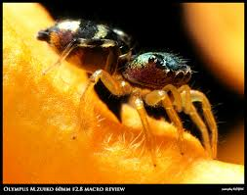
Extreme Close Up Examples

Slide 14
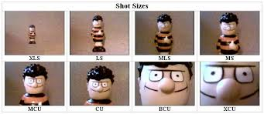
Comparisons of Framing Shots

Slide 15
Camera ANGLES
BIRD’S-EYE VIEW
Shows scene/shot from directly overhead
Sometimes making object unrecognizable
God-like view

Slide 16
Camera ANGLES
High Angle
Similar to but not as severe as Bird’s-Eye View
Camera is elevated and looks down on subjects
Makes subject seem smaller, less significant

Slide 17
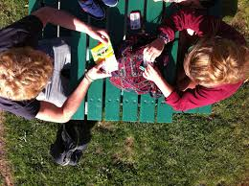
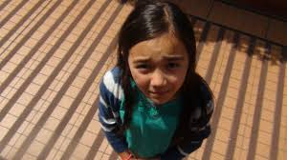
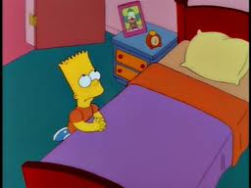
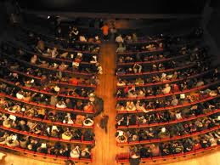
Bird’s Eye v. High Angle

Slide 18
Camera ANGLES
EYE LEVEL
A neutral shot
Approximates “normal” vision
Most common angle used

Slide 19
Camera ANGLES
LOW ANGLE
Camera is place BELOW normal use
Subjects appear bigger
Can be used to make audience feel inferior or confused
Background in Low Angle shots are often the sky or ceiling

Slide 20
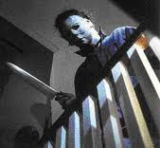
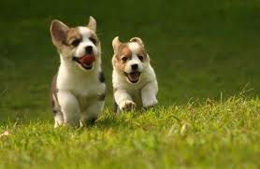
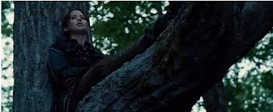
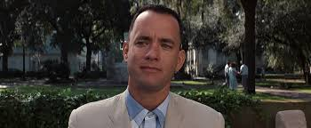
Low Angle & Eye Level Examples

Slide 21
Camera ANGLES
OBLIQUE/CANTED ANGLE
The camera is tilted
Suggests confusion, being unbalanced, or mental instability

Slide 22
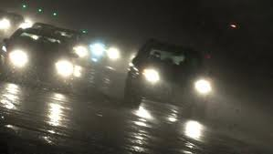
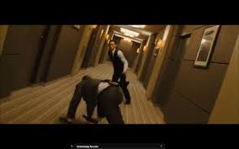
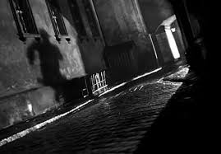
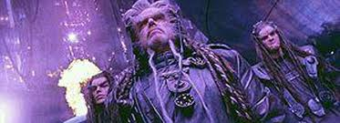
Oblique/Canted Angle Examples

Slide 23
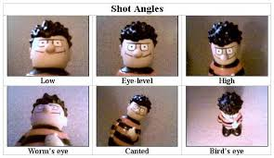
Comparisons of Camera Angles

Slide 24
Camera Movement
Instead of a series of CUTS (going from one shot to another) director’s often choose to move camera
Makes the action seem slower
Takes more time to watch, to set up to film

Slide 25
Camera Movement
PAN SHOT
The movement scans the scene horizontally
This pans or scans over the scene, like looking side to side
TILT SHOT
The movement scans the scene vertically
This pans or scans the scene up & down

Slide 26
Camera Movement
DOLLY/TRACKING SHOT
The camera moves ALONG the action or subject.
The camera is either on free standing wheels or on a train-track like device
BOOM or CRANE SHOT
The camera moves vertically through space
This can also include side to side through space (not on the ground).

Slide 27
Camera Movement
Zoom
This changes the magnification of the subject
This applies to both increasing size (Zoom IN) and decreasing size (Zoom OUT)
Should be thought of as a sfx and used sparingly

Slide 28
Camera Movement Examples
http://www.lavideofilmmaker.com/filmmaking/film-techniques.html

